Slide 1


CODEFURY 2024 - MultiThreaders
WSF2_Team4
HOSPITAL MANAGEMENT SYSTEM

Slide 2
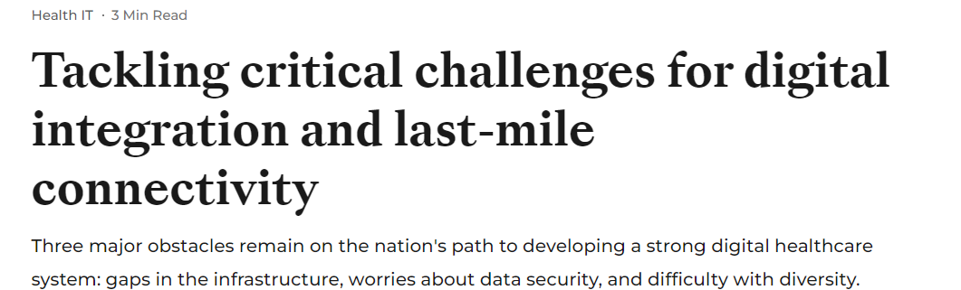
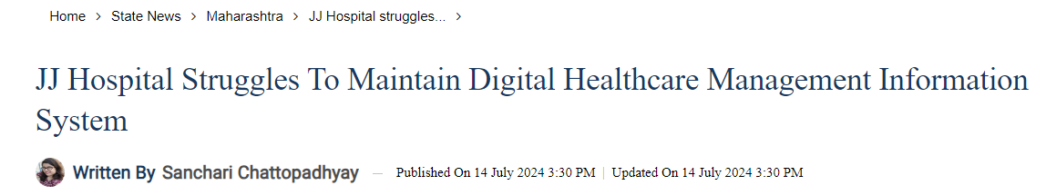
THE REAL-WORLD PROBLEM

Slide 3
Introduction
The Hospital Management System (HMS) is designed to streamline and automate the operations of healthcare facilities. This project aims to provide an integrated solution for managing hospital resources, patient information, doctor schedules, and administrative tasks. By leveraging modern software engineering practices, the system ensures efficient and secure handling of sensitive data, such as patient records, appointments, and medical prescriptions.
MODULES:
Employee Management
Doctor
User
Admin
Patient Management
Appointing Schedules
Medication and Testing

Slide 4

FEATURES:
AUTHENTICATION
Secure login system for different types of users (patients, doctors, admins).
USER MANAGEMENT
Register new patients
Book and manage appointments
DOCTOR MANAGEMENT
Set and update Availability
Cancel and manage appointments
ADMIN FUNCTIONS
Add or remove user or doctors
Manage overall hospital schedules and appointments.

Slide 5




Our services
Appointment Booking
Patient Management
Employee Management
Medication and Testing
Allows users to book appointments on behalf of patients with doctors based on availability. The system tracks doctor schedules, shifts, and ensures conflict-free appointments.
Manages patient records, including personal details, medical history, and treatment plans. It also facilitates patient registration and ensures the accuracy and privacy of patient data.
Handles the creation, updating, and management of hospital staff, including doctors and administrative personnel. Role-based access control ensures that only authorized users can access specific features
Provides doctors with the ability to prescribe medications and order tests for patients. It keeps a detailed record of prescriptions and test results, ensuring continuity of care

Slide 6
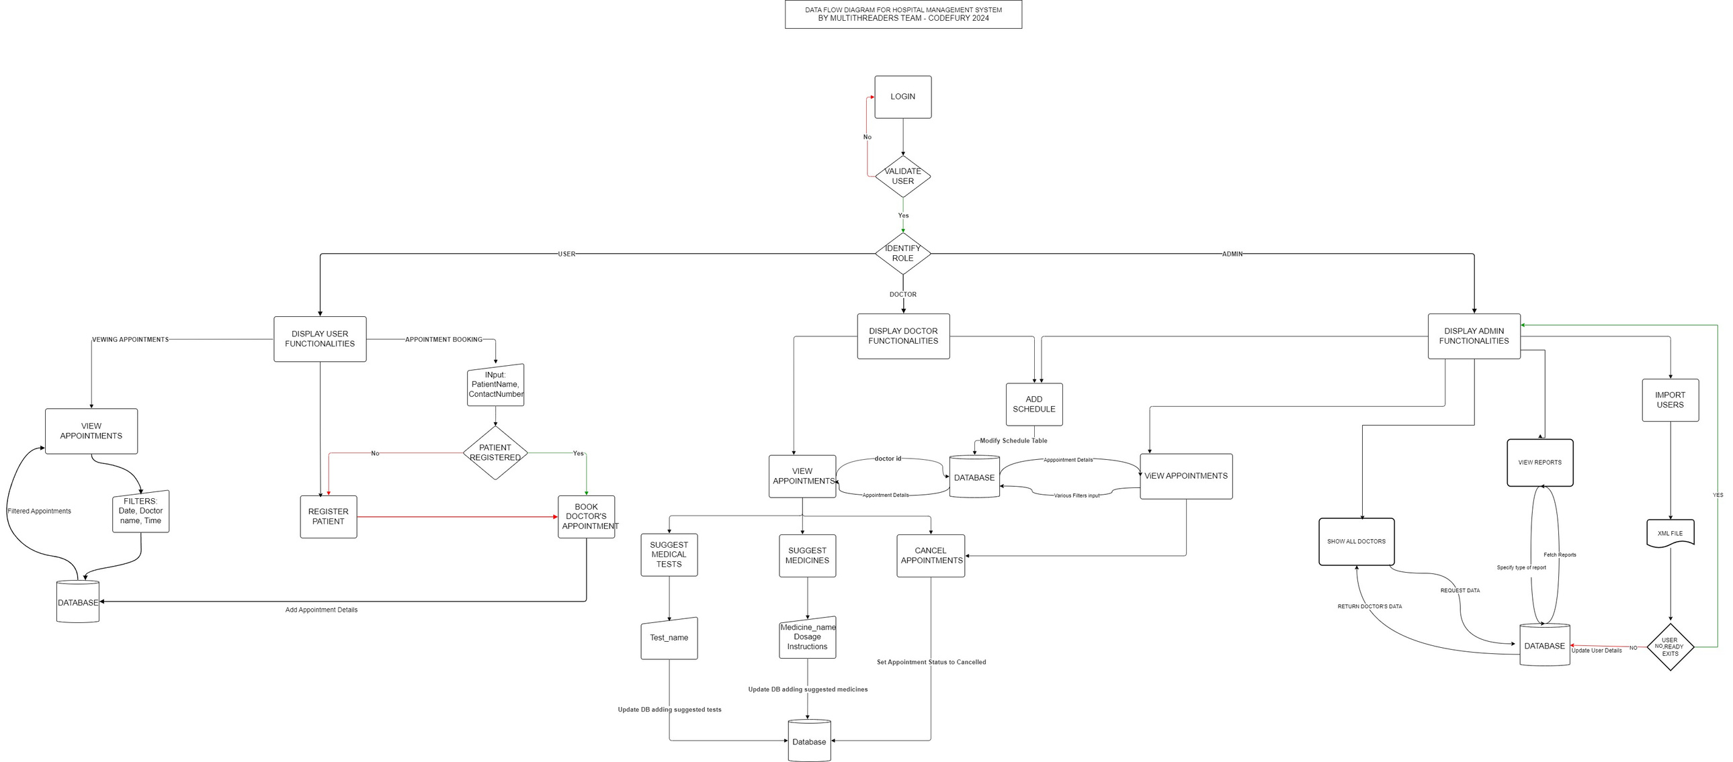
DATA FLOW DIAGRAM

Slide 7
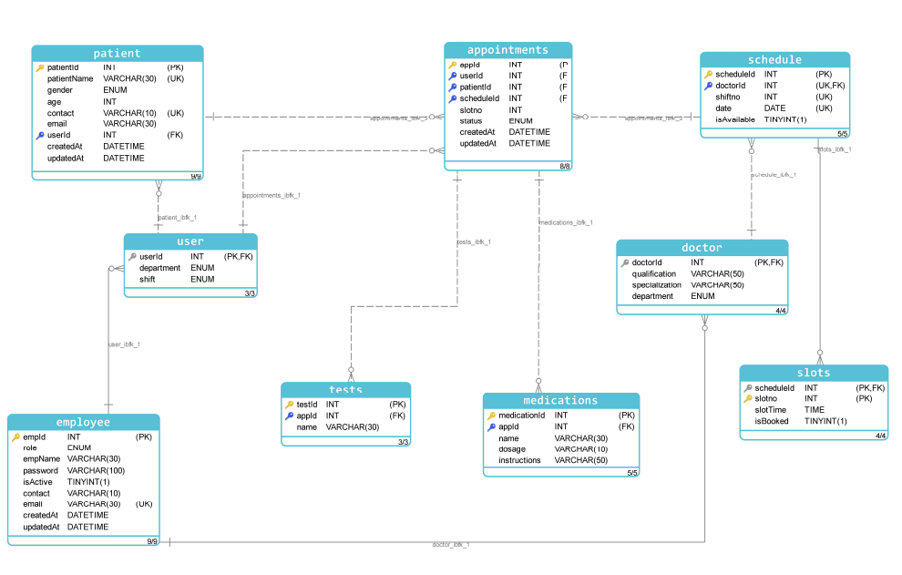
ER DIAGRAM

Slide 8
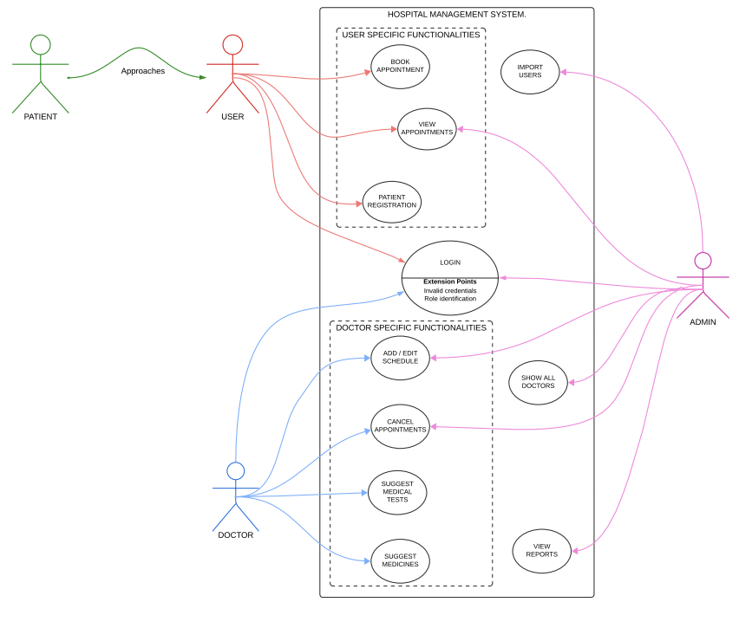
USE CASE DIAGRAM

Slide 9

USER RELATED FEATURES:
BOOKING APPOINTMENTS
Users can search for doctors by specialization.
View available slots based on the selected doctor and date.
Book appointments directly through the system.
Users can check available slots for a doctor on a particular date before booking.
REGISTERING A PATIENT:
Users can register new patients by providing their names, contact details, and other relevant information.
The system automatically assigns a unique patient ID.

Slide 10
DOCTOR RELATED FEATURES:
MANAGING SCHEDULE:
Doctors can set their availability every three days.
Scheduling is allowed only for the upcoming three days and is repeated exactly every three days.
Example: If today is Monday, the schedule can be set for Tuesday, Wednesday, and Thursday only.
CANCELLING INDIVIDUAL APPOINTMENTS
Doctors have the ability to cancel specific patient appointments.
Patients receive notifications about appointment cancellations.
The system updates the appointment status to "Cancelled."

Slide 11
DOCTOR RELATED FEATURES:
ADDING SLOTS:
Doctors can add new available slots every three days, ensuring no overlapping with other appointments.
The system automatically restricts doctors from setting availability for the next three days.
CANCELLING INDIVIDUAL APPOINTMENTS
Doctors can cancel specific patient appointments.
Patients receive notifications about appointment cancellations.
The system updates the appointment status to "Cancelled."

Slide 12
DOCTOR RELATED FEATURES:
ADDING SLOTS:
Doctors can add new available slots every three days, ensuring no overlapping with other appointments.
The system automatically restricts doctors from setting availability for the next three days.
UPDATING AVAILABILITY:
Doctors can update their status from "Available" to "Unavailable" and ViceVersa
When availability is changed:
All future slots for that period are canceled.
The system updates the appointment and slot status.

Slide 13
ADMIN RELATED FEATURES:
ADDING DOCTORS AND USERS:
Admins have the authority to add new doctors and users (patients).
A user form collects necessary information like name, contact details, and specialization for doctors.
Admin can even import users from an XML or JSON File.
GENERATING REPORTS :
Patient Reports: Details of appointments, history, and upcoming schedules.
Doctor Reports: Information on doctor schedules, patient appointments, and availability.
User Reports: General reports on system usage, user engagement, and appointment metrics.

Slide 14
ADMIN RELATED FEATURES:
UPDATING DOCTOR SCHEDULE:
Admins can modify a doctor's schedule from "Available" to "Unavailable" and Vice-versa
This action automatically cancels all slots and appointments scheduled for that period.
CANCELING INDIVIDUAL APPOINTMENTS:
Admins can cancel specific patient appointments on behalf of doctors.
REMOVING EMPLOYEES
Admins can deactivate employees (doctors or other staff) by setting their isActive status to false.
Deactivated users cannot log in or access the system.
Existing appointments associated with the deactivated doctor are canceled and affected patients are notified.

Slide 15
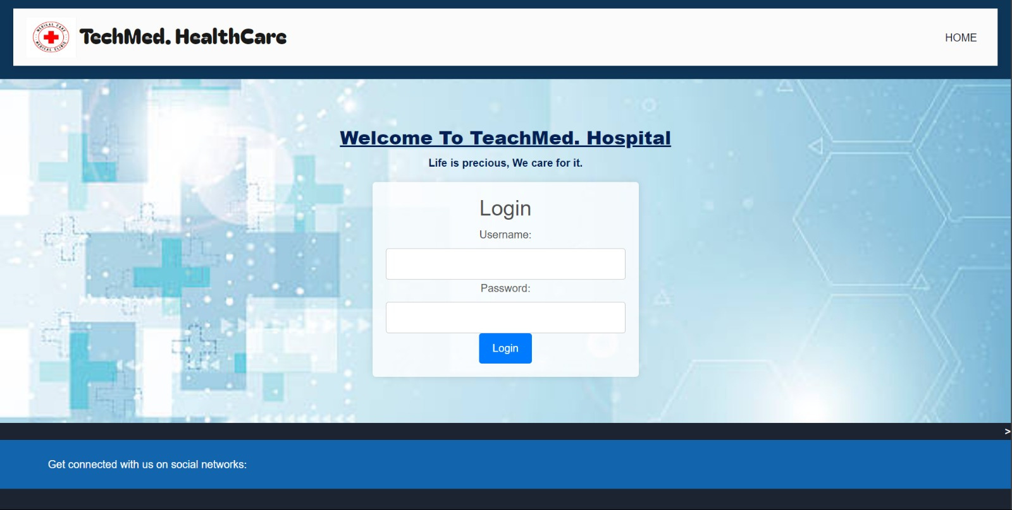
UI INTERFACE

Slide 16
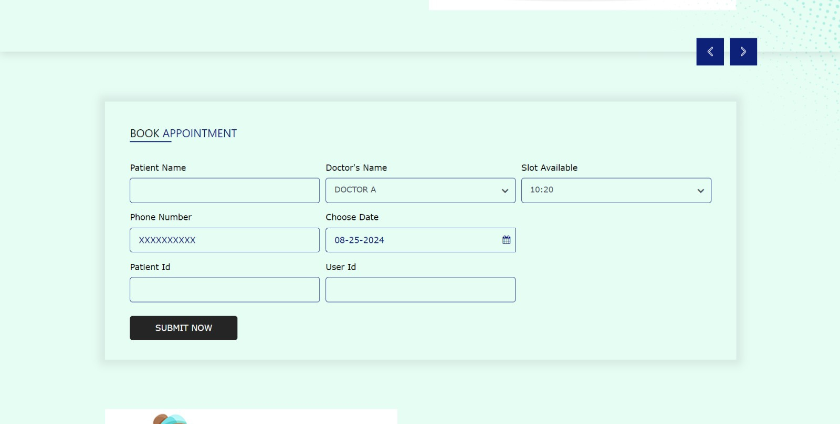
BOOKING AN APPOINTMENT

Slide 17
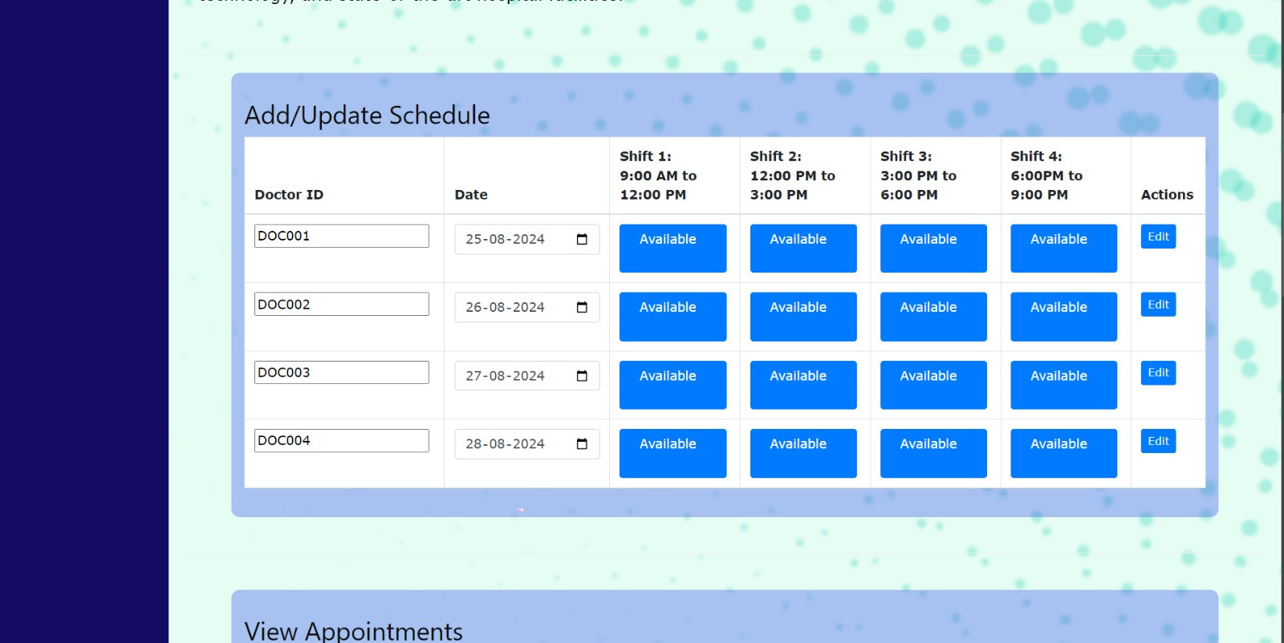
ADD/UPDATE DOCTOR SCHEDULE

Slide 18
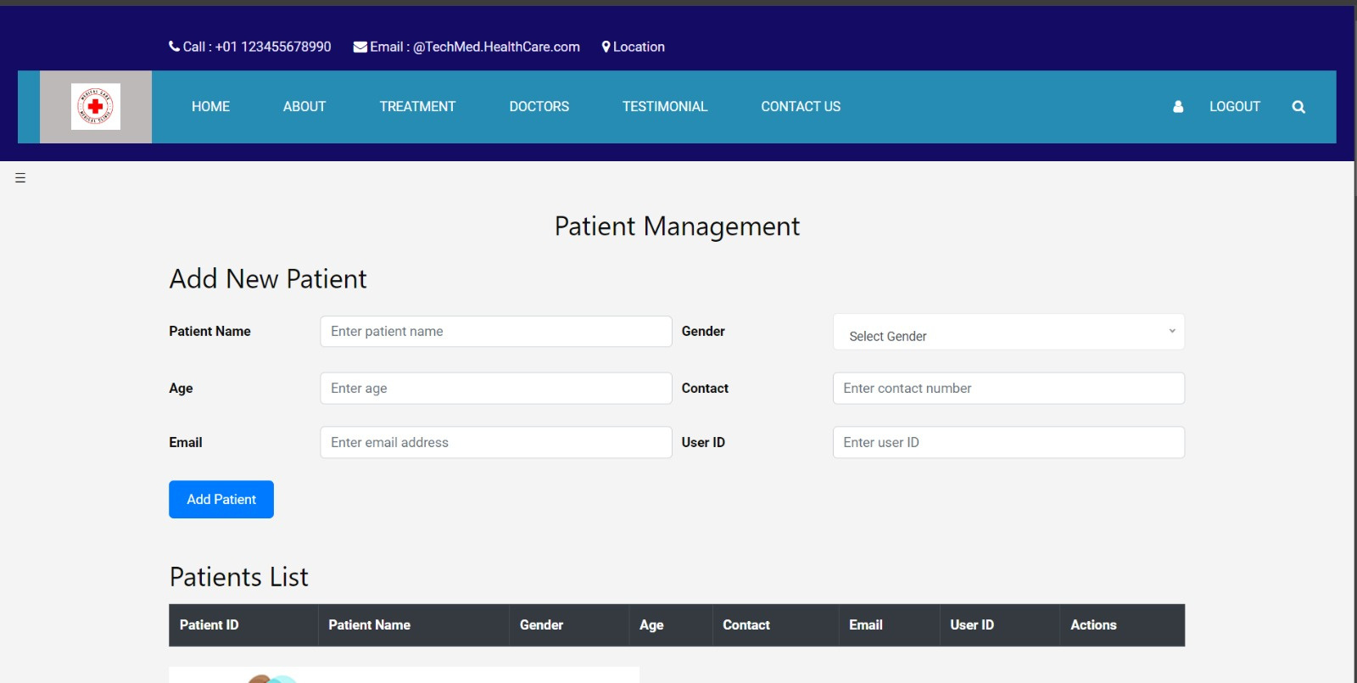
PATIENT MANAGEMENT:

Slide 19
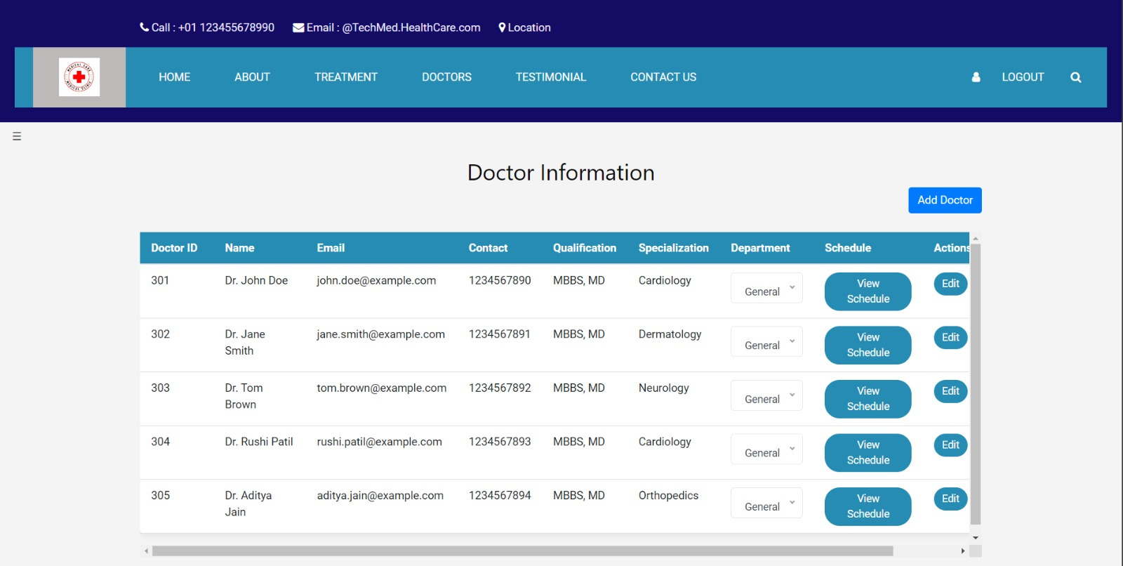
DOCTOR’S DETAILS

Slide 20
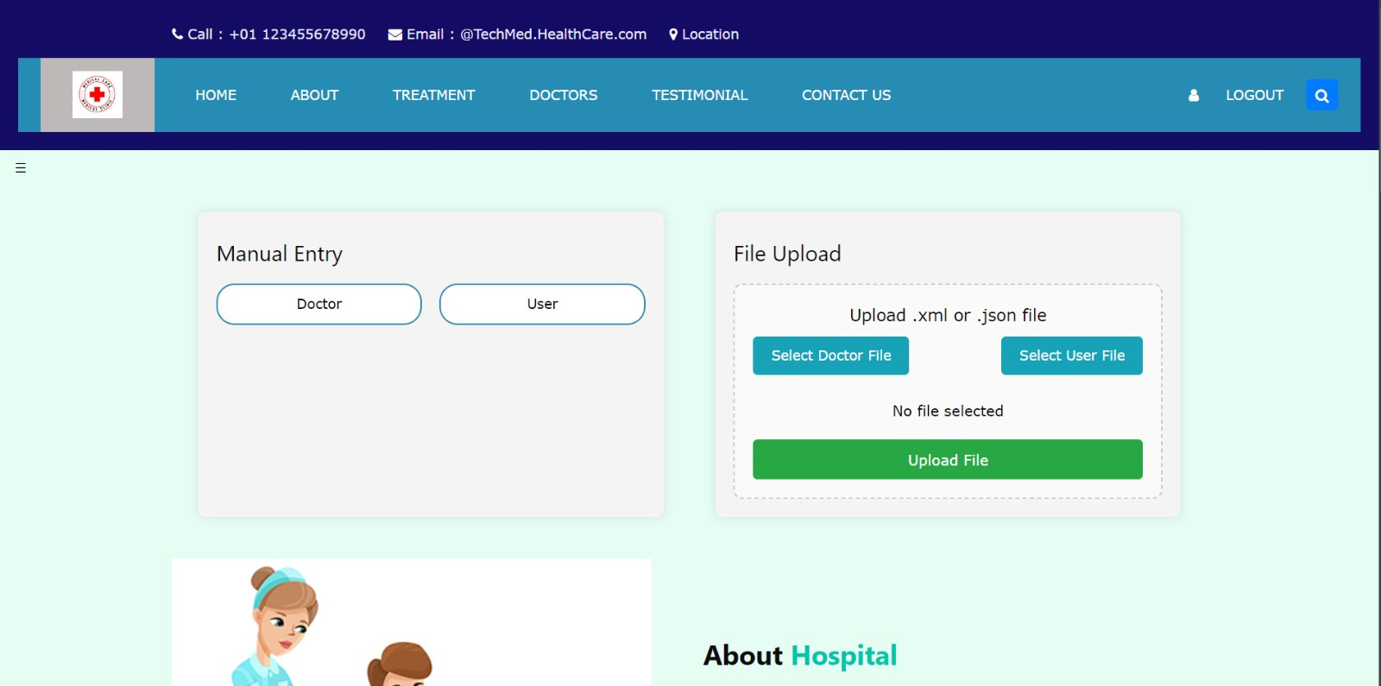
IMPORTING NEW USERS

Slide 21
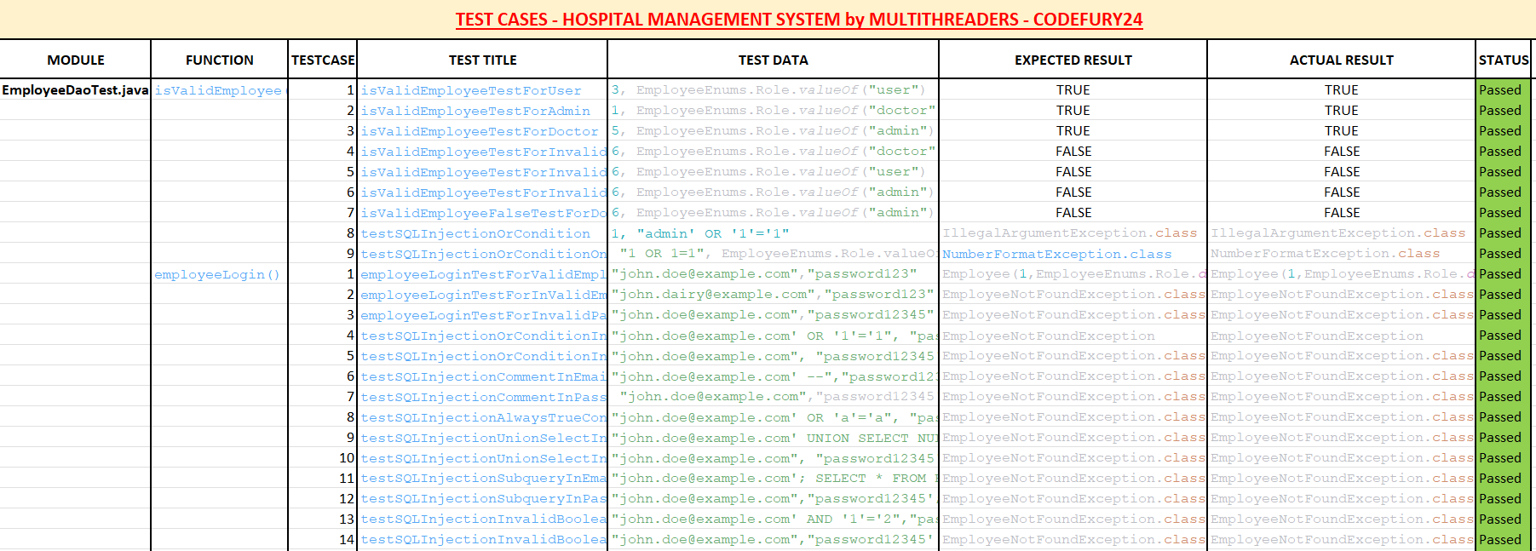
TESTING:

Slide 22
Our Team
ANUSHKA
KHUSPE
BHANU PRASAD PAITAR
DEEPANSHI
RAJPUT
FRONT END DEV.
BACK END DEV
FRONT END DEV.
KUHOO
AGARWAL
KULMEET
SINGH
MD
AREEB
FRONT END DEV.
BACK END DEV.
BACK END DEV.
PRIYANSHI KHAMBOJ
FRONT END DEV.

Slide 23
Thank you

